Slide 1
CODE ESCAPE
Ernie Ledezma, Dani Odicho, Tariq Rafiq, Joseph Peña, Abel Lawal, Oscar Lugo, Jose Pech, Kasun Hettiarachchi

Slide 2
What is CodeEscape?
First-Person Educational game
Teaches basics of Java programming
Puzzles

Slide 3
Puzzles:
Hello world (Print-out)
Ints and doubles
Indentation
Input Scanner
Random number generation
If statements
While loops
For loops
Arrays
Methods

Slide 4






Tools
Unity
Monodevelop
Blender
Photoshop
Github
Google Drive

Slide 5
Accomplishments
Learned Unity
Learned Basics of Blender
Completed Puzzle 1
Completed Puzzle 2

Slide 6
How does the game work?
Rooms
Jack-in ports
User interface
Terminal
Scripts

Slide 7
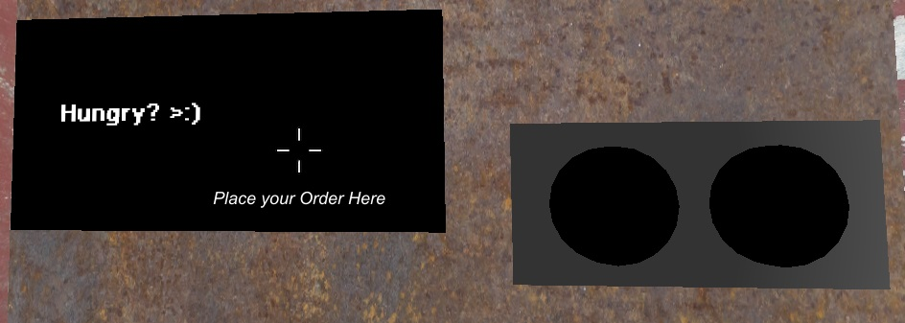
Terminals

Slide 8

Wall Texture

Slide 9
Wall Texture
Find Wall Texture Online
Unity allows drag and drop
Hints for User
Photoshop

Slide 10
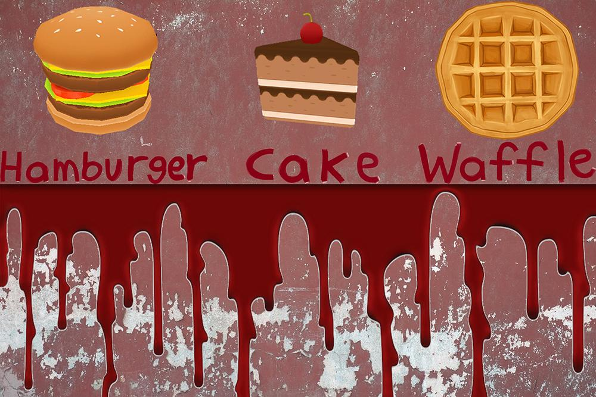
Wall Texture/Food Objects

Slide 11
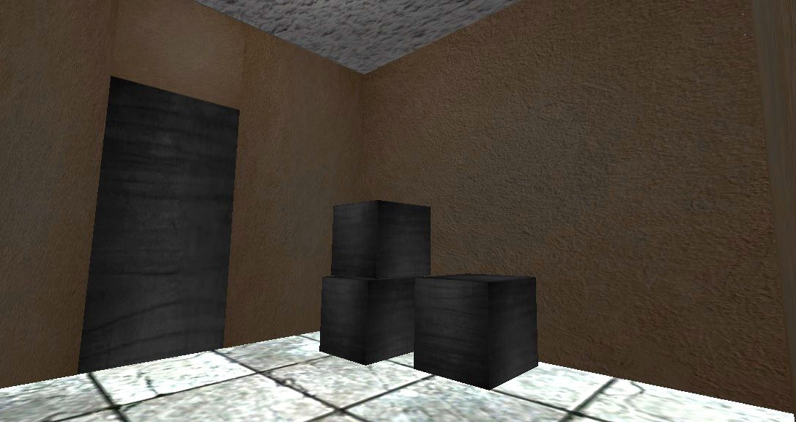
Rooms

Slide 12
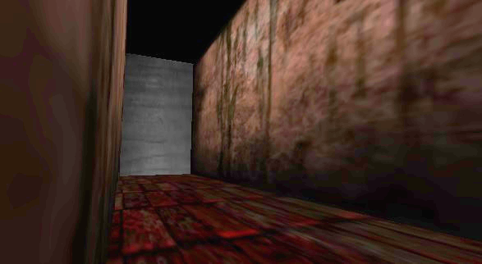
Corridor

Slide 13
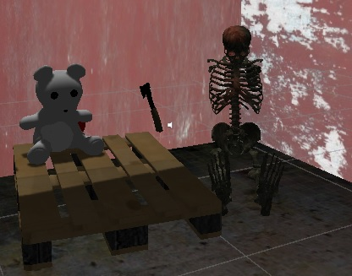
Game Objects
AC3D
Anything creepy
Potential for clues
Helps fill a room

Slide 14
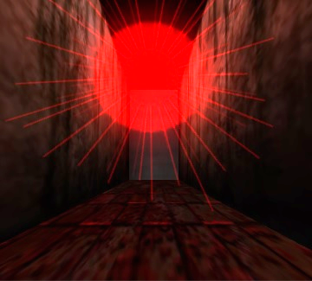
Effects
Consistent Feel
Horror Theme
Visual Cues

Slide 15
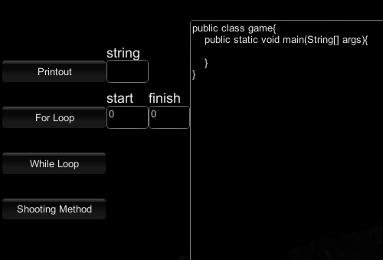
User Interface
Code View
Code Edit
Submit/Cancel

Slide 16
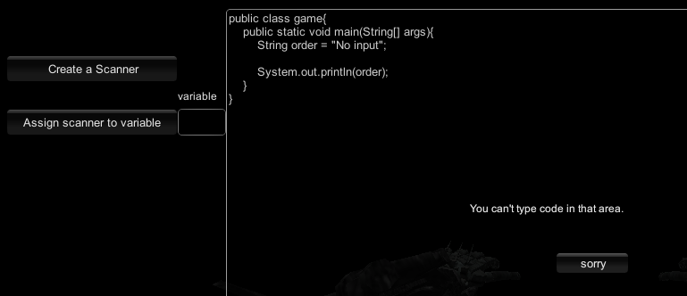
Error Checking

Slide 17
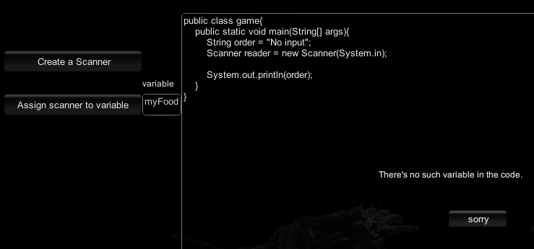
Helpful feedback

Slide 18
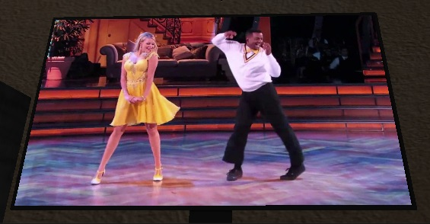
Audio/Video

Slide 19
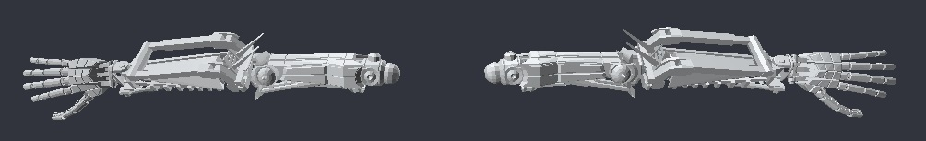
Robot Arms
FPS character
Made in Blender
138 bones
Salvaged Armature and polygon object

Slide 20
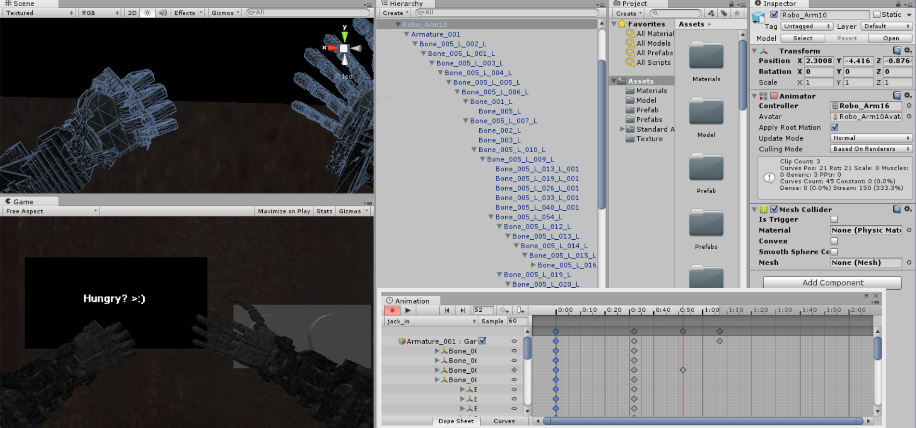
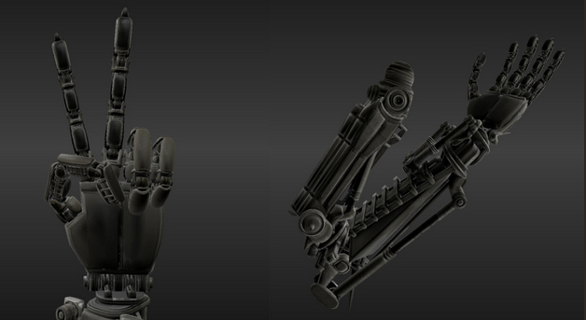
Animation
Blender & Unity
Animation States
Key Frames
Scripting animation to gameplay

Slide 21

Door/Button
Used to Enter/Exit Rooms
Basic Animations Such as Button Depressing/Door Opening

Slide 22
Current State of the Game
This semester is Functionality
-Familiarize with tools
-Ideas and level design
-Something that works
Next Semester enhancements
-Make the game pretty
-Round out more puzzles
-Finishing game touches

Slide 23
SCRUM
Bi-weekly Meetings
Concerns/problems
Progress
End of Sprint “Wrap-ups”
Backlog Update

Slide 24
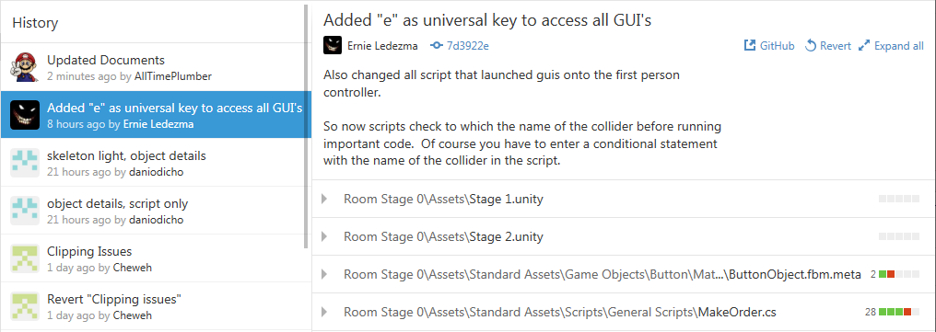
Github

Slide 25
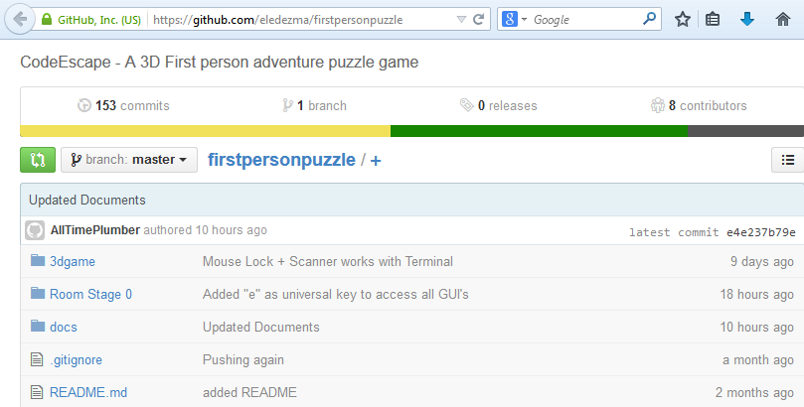
PAL

Slide 26
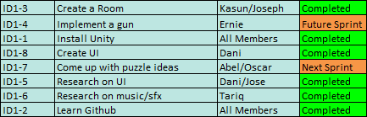
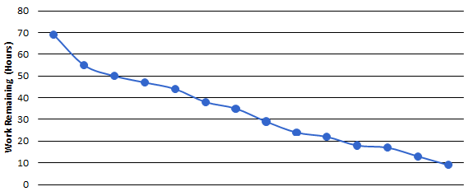
Sprint 1

Slide 27
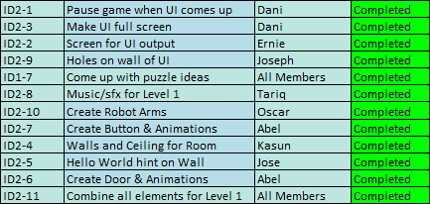
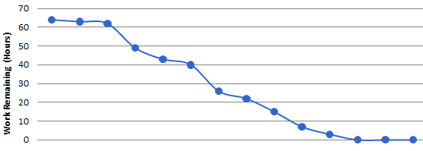
Sprint 2

Slide 28
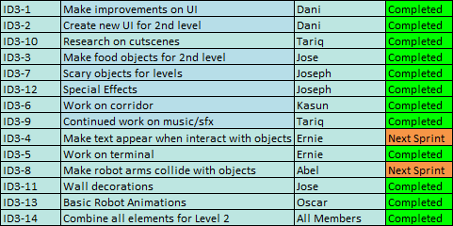
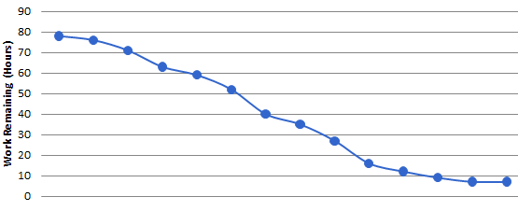
Sprint 3

Slide 29
Risks
Balancing the educational/fun aspect of the game.
How big is the market for a Java Beginner game?
Potential competition from other games

Slide 30

Questions

